Slide 2
Prevalence and Predictors of Etravirine Resistance in HIV-Positive Individuals Failing Second-Line Antiretroviral Therapy in Uganda
Dr. Grace Namayanja – Kaye
24 July 2019
Namayanja-Kaye Grace,¹ Awor Anna C,¹ Katureebe Cordelia,² Nakaweesi Jane,³ Ssonko Michael,³ Namusoke Magongo Eleanor,² Sewanyana Isaac,⁵ Nansumba Hellen⁵, Adler Michelle,¹ Watera Christine,⁵ Jacobson Kathleen,¹ Namale Alice,¹ Raizes Elliot,⁶ Ssali Francis,⁷
1.Centers for Disease Control and Prevention, Kampala, Uganda, 2.Ministry of Health AIDS Control Program, Kampala, Uganda, 3.Mildmay Uganda, Kampala, Uganda, 4. Uganda Virus Research Institute, Entebbe, Uganda, 5. Central Public Health Laboratories, Kampala, Uganda, 6.Centers for Disease Control and Prevention, Atlanta USA, 7.Joint Clinical Research Center, Kampala Uganda

Slide 3
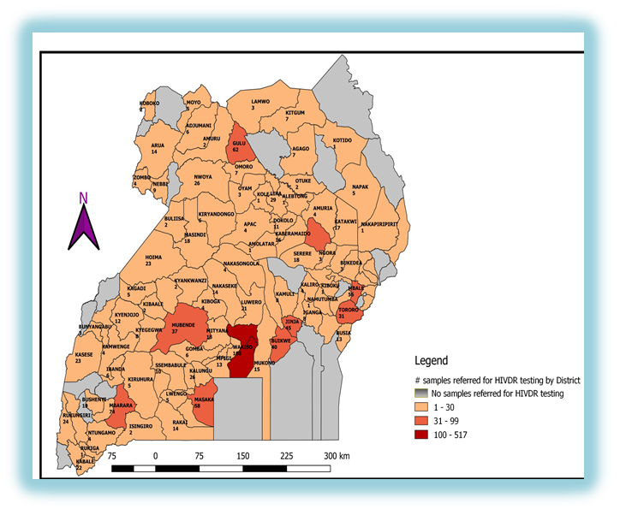
Prevalence and Predictors of Etravirine Resistance in HIV-Positive Individuals Failing Second-Line Antiretroviral Therapy in Uganda
Background
WHO recommends Etravirine (ETR) as one of the three backbone drugs for empiric third-line antiretroviral therapy (ART) in absence of genotyping
The 2016 Uganda HIV treatment guidelines recommend HIV drug resistance (HIVDR) genotyping for patients failing protease inhibitors (second line)
Beginning June 2017, Uganda began routine HIVDR genotyping for all PLHIV failing second-line regimens (defined as two successive non-suppressed viral load results, done 6 months apart)
Individuals failing second-line therapy may have resistance mutations hindering use of ETR for effective third line
This analysis assesses prevalence and predictors of ETR resistance in HIV patients failing second- line therapy in Uganda
Methods
Dried blood spots (DBS) from rural facilities and plasma from peri-urban facilities were sent to the Central Public Health Laboratory for routine viral load (VL) testing
Repeat DBS and Plasma non-suppressed viral load samples were sent to the Uganda Virus Research Institute and Joint Clinical Research Center respectively
Genotype results were used to determine third-line regimens by the National Third Line ART Committee
A retrospective cross-sectional review of de-identified data for patients failing second line from June 2017 to November 2018 was conducted
ETR resistance-associated mutations (RAMs) were scored using the Tibotec genotypic weighting scale, an ETR Score of (ETR-S) ≥2.5 was considered ETR resistance
Figure 1: Number of HIVDR samples from 100 Districts in Uganda

Slide 4
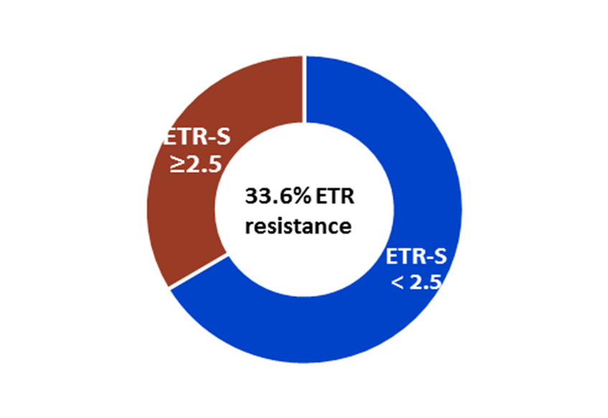
Prevalence and Predictors of Etravirine Resistance in HIV-Positive Individuals Failing Second-Line Antiretroviral Therapy in Uganda
Figure 2: Prevalence of Etravirine Resistance in Uganda from June 2017 to November 2018
Results
Genotype results were reviewed from 267 clients failing second line
Two excluded for missing data
43% females; 25% children < 15 years
Non-nucleoside reverse transcriptase inhibitor (NNRTI) exposure and resistance
NNRTI mutations found in 224 (84.5%) clients
No significant difference in ART duration between first line NVP vs EFV exposure (4.8 vs 4.5 years; p=0.512)
ETR RAMs: Found in 171 (64%) clients
Mean ETR-S = 1.5 (SD±0.66); no significant difference between adults and children (1.49 vs 1.64; p=0.477).
Almost all (168; 98.5%) had previous NNRTI exposure; Mean ETR-S=1.7 for NVP vs Mean ETR-S=1.1 for EFV (p=0.003).
Most common mutations: G190A (26%), A98G (17%), and Y181C (17%).
ETR resistance
An ETR-S score of ≥2.5 (signifying ETR resistance) was found in 89 (33.6%) clients.
No significant difference was found in ETR-resistance based on sex, age, or NNRTI exposure (NVP vs EFV).
Table 1: Predictors of Etravirine Resistance from 100 districts in Uganda from June 2017 to November 2018

Slide 5
Conclusions and Recommendations
Conclusions
One-third of clients failing second line ART are already resistant to ETR
Neither sex, age, nor prior NNRTI exposure were significant predictors of Etravirine resistance
NVP exposure is correlated significantly with higher mean ETR-S score but not with ETR resistance
Recommendations
Given the high prevalence of ETR resistance among clients failing second line in Uganda, ongoing investment in HIVDR testing for this population to guide third line regimen selection is warranted
Other resource-limited countries may consider investment in HIVDR for those failing second line

